Slide 1
课程论文
主题：本课程相关
字数：3000字
时间：第十周（各班级收齐交给我）
要求：不要抄袭！
不要抄袭！
不要抄袭！

Slide 2
Amino-resin Wood Adhesives

Slide 3
Main content:
1 Introduction
2 Chemistry of Amino-resins
3 Manufacture and Application

Slide 4
INTRODUCTION

Slide 5
Amino-resin Wood Adhesives--Introduction
Amino-resins are polymeric products of aldehyde’ s reaction with compounds arraying -NH₂ or -NH groups.

Slide 6
Amino-resin Wood Adhesives--Introduction
Such groups are mainly amide groups, such as those in urea and melamine.

Slide 7
Amino-resin Wood Adhesives--Introduction
They constitute the most important members of these compounds, more than the other amine groups such as aniline （ rarely ）.

Slide 8
Amino-resin Wood Adhesives--Introduction
Formaldehyde is the main aldehyde used. Other aldehydes, such as furfural, which are generally not used for manufacture of wood adhesives.

Slide 9
Amino-resin Wood Adhesives--Introduction
The advantages of amino-resin adhesives

Slide 10
Amino-resin Wood Adhesives--Introduction
Initial water solubility (which renders them eminently suitable for filler and relatively inexpensive product)
Notes:
作为胶粘剂具有初期的水溶性，这就赋予了这类胶粘剂与填料良好的相容性，并是一种相对相对较便宜的产品。

Slide 11
Amino-resin Wood Adhesives--Introduction
Hardness
Non-flammability
Good thermal properties
Notes:
良好的硬度，阻燃性，好的热性能；

Slide 12
Amino-resin Wood Adhesives--Introduction
Absence of color in cured polymers
Strong adaptability to a variety of curing conditions.
Notes:
固化后的胶层无色，对固化条件的适应性强。

Slide 13
Amino-resin Wood Adhesives--Introduction
Although many amino-compounds have been investigated for using in production of amino-resins, only urea and melamine, in rare cases aniline, are extensively used.

Slide 14
Amino-resin Wood Adhesives--Introduction
Thermosetting amino-resins produced from reaction between formaldehyde and urea (melamine) , which are based on condensation polymerization.

Slide 15
Amino-resin Wood Adhesives--Introduction
Urea or melamine are reacted with formaldehyde, which results in the formation of addition products, such as methylol compounds.
Notes:
尿素、三聚氰胺和甲醛反应，从而有加成后的羟甲基化合物的生成。

Slide 16
Amino-resin Wood Adhesives--Introduction
Further reaction, and the concurrent elimination of water, leads to the formation of low molecular weight poly- condensates which are still soluble.
Notes:
下一步将发生脱水反应，并有低摩尔质量的但仍是可溶的树脂生成。

Slide 17
Amino-resin Wood Adhesives--Introduction
Higher molecular weight products, which are insoluble and infusible, are obtained by further condensing the low molecular weight polycondensate.
Notes:
进一步发生的缩聚反应将会使低分子的缩聚物生成不溶不熔的高分子量的产品（树脂）。

Slide 18
Amino-resin Wood Adhesives--Introduction
Urea- and melamine-formaldehyde (UF and MF) resins have a great deal in common， such as chemical and physical characteristics of both the cured and uncured resins.

Slide 19
Amino-resin Wood Adhesives--Introduction
MF is superior to UF because of its superior water and heat resistance, hardness, and shorter curing time under less drastic conditions.
Notes:
与脲醛树脂相比，三聚氰胺甲醛树脂有更好的耐水和耐热性，硬度，并且固化时间短，对固化条件的要求也没有脲醛树脂严格。

Slide 20
Amino-resin Wood Adhesives--Introduction
The greatest disadvantage of MF
Their bond deterioration, which caused by hydrone (water and moisture).
Notes:
MF树脂最大的缺点是其化学键由于水和湿引起的老化。

Slide 21
Amino-resin Wood Adhesives--Introduction
This is due to the hydrolysis of the amino-resin or amino-methylene bond, which is the same for both UF and MF resins.

Slide 22
Amino-resin Wood Adhesives--Introduction
The higher resistance of MF resins to water attack is due to the considerably lower solubility of melamine in water.

Slide 23
Amino-resin Wood Adhesives--Introduction
Melamine dissolves in hot water only, whereas urea dissolves in cold water as well. Therefore, UF adhesives are used for interior application only;

Slide 24
Amino-resin Wood Adhesives--Introduction
MF or melamine-urea-formaldehyde (MUF) resins can be employed successfully even for rather severe outdoor conditions.

Slide 25
Amino-resin Wood Adhesives--Introduction
If full exterior-grade quality is needed, it is safer to use phenolic-type resins rather than amino-resins.

Slide 26
Summary
Amino-resin
UF
MF ( MUF)

Slide 27
CHEMISTRY OF AMINORESINS

Slide 28
Urea-Formaldehyde Condensation
The reaction between urea and formaldehyde is very complex. The
combination of these two chemical compounds results in both linear and branched polymers, as well as tri-dimensional networks in the cured resin.

Slide 29
Urea-Formaldehyde Condensation
This is due to a functionality of 4 in urea (due to the presence of four replaceable hydrogen atoms), and a functionality of 2 in formaldehyde.

Slide 30
Urea-Formaldehyde Condensation
The most important factors determining properties of the reaction products：
(1) the relative molar proportion of urea and formaldehyde
(2) the reaction temperature
(3) the various pH values at which the condensation takes place.

Slide 31
Urea-Formaldehyde Condensation
These factors influence the rate of increase of the molecular weight of the resin.

Slide 32
Urea-Formaldehyde Condensation
Therefore, the characteristics of the reaction products differ considerably when lower and higher condensation stages are compared, especially in solubility, viscosity, water resistance, and rate of curing.

Slide 33
Urea-Formaldehyde Condensation
To a large extent , these all depend on molecular weights.

Slide 34
Summary
Governing factors
Molecular weight

Slide 35
Reaction Mechanism

Slide 36
The reaction between urea and formaldehyde is divided into two stages.
Urea-Formaldehyde Condensation

Slide 37
The first is the alkaline addition to form mono-, di-, and tri-methylolureas. (Tetra-methylolurea has never been isolated)
Urea-Formaldehyde Condensation

Slide 38
The second stage is the acid condensation of methylolureas, that first to soluble and then to insoluble cross-linked resins.
Urea-Formaldehyde Condensation

Slide 39
On the alkaline side, the reaction of urea and formaldehyde at room temperature leads to the formation of methylolureas.
Urea-Formaldehyde Condensation

Slide 40
The products from urea and formaldehyde, mono- and di-methylolureas, are as follows:
Urea-Formaldehyde Condensation

Slide 41
Urea-Formaldehyde Condensation

Slide 42
On the acid side, the products precipitated from aqueous solutions of urea and formaldehyde, such as methylolureas, low molecular weight methyleneureas.
Urea-Formaldehyde Condensation
Notes:
Precipitated沉淀；methylolurea羟甲基脲；methyleneurea亚甲基脲

Slide 43
Urea-Formaldehyde Condensation
The formation of unsaturated azomethine groups (e.g., those from mono-methylolurea). This unsaturated group is supposed to polymerize easily to polymethyleneurea:
NH ₂CONHCH ₂OH NH ₂ CON=CH + H ₂O

Slide 44
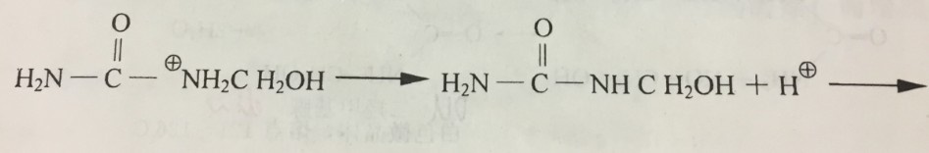
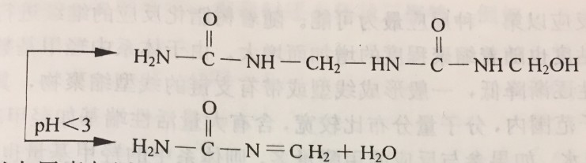

Slide 45
Urea-Formaldehyde Condensation
In the reaction, monomeric methyleneurea is formed as a result of the intramolecular loss of water. An unsaturated azomethine group is formed, followed by rapid polymerization. This gives the insoluble end product
Notes:
Intramolecular分子内的azomethine甲亚胺

Slide 46
Urea-Formaldehyde Condensation
To conclude, the increase in the molecular size of UF resins is probably caused by the following reactions, all of which occur with the simultaneous liberation of water, and in some cases of formaldehyde:

Slide 47
Urea-Formaldehyde Condensation
1 The formation of methylene bridges between methylol and amino groups of neighboring molecules:
RNHCH₂OH + NH₂R' RNHCH₂NHR' + H₂O

Slide 48
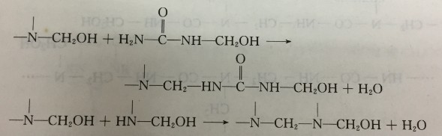

Slide 49
Urea-Formaldehyde Condensation
2. The formation of methylene bridges between two methylol groups by splitting off formaldehyde:
RNHCH₂OH + HOCH₂NHR RNHCH₂NHR' + H₂O + HCHO

Slide 50


Slide 51
Urea-Formaldehyde Condensation
3. The formation of methylene-ether bridges by reaction of methylol groups of neighboring molecules:
RNHCH₂OH + HOCH₂NHR' → RNHCH₂OCH₂NHR'

Slide 53

Question
Which is the dominating reaction?

Slide 54
Urea-Formaldehyde Condensation
The other reactions are condensation polymerizations in which the methylolureas are merely building blocks of the polymers and of the insoluble end product.

Slide 55
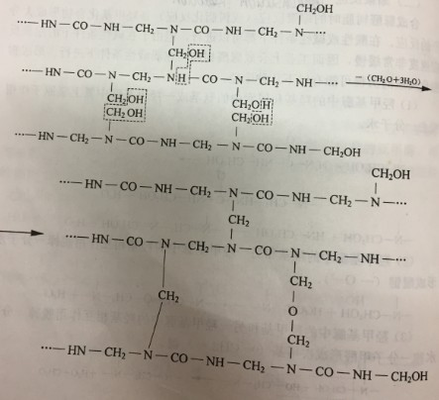

Slide 56
Urea-Formaldehyde Condensation
The polymers formed in both cases are mainly linear polymers obtained by the intermolecular splitting off of water. Under certain conditions water may also be split off intramolecularly.

Slide 57
Urea-Formaldehyde Condensation
Cyclic compounds called urones are then formed. In both cases, further splitting off of water and formaldehyde leads to the formation of hardened or cured resins.

Slide 58
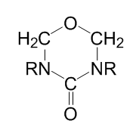
Uron（糖醛）
R=H, CH₂OH, CH₂OCH₃

Slide 59
Summary
UF
Two stages
Addition reaction of urea with formaldehyde
Condensation reaction of methylolureas
UF curing

Slide 60
Melamine-Formaldehyde Condensation

Slide 61
Melamine-Formaldehyde Condensation
The addition reaction of melamine with formaldehyde is similar to the reaction of formaldehyde with urea. Formaldehyde first attacks the amino groups of melamine, forming methylol compounds.

Slide 62
Melamine-Formaldehyde Condensation

Slide 63
Melamine-Formaldehyde Condensation
Formaldehyde addition to melamine occurs more easily and completely than to urea.
The amino group in melamine accepts easily up to two molecules of formaldehyde.

Slide 64
Melamine-Formaldehyde Condensation
Thus up to six molecules of formaldehyde are attached to a molecule of melamine.
The methylolation step leads to a series of methylol compounds with two to six methylol groups.

Slide 65
Melamine-Formaldehyde Condensation
Because melamine is less soluble in water than urea, the hydrophilic stage proceeds more rapidly in MF resin formation than in UF condensations. Therefore, hydrophobic intermediates of the MF condensation appear early in the reaction.
Notes:
Hydrophilic亲水性

Slide 66
Melamine-Formaldehyde Condensation
Another important difference between MF and UF is that the MF condensation and curing occurs not only under acid conditions, but also under neutral or even slightly alkaline conditions.
Notes:
Hydrophilic亲水性

Slide 67
Melamine-Formaldehyde Condensation
The mechanism of the further reaction of methylolmelamines to form hydrophobic intermediates is the same as for UF resins, with splitting off of water and formaldehyde.

Slide 68
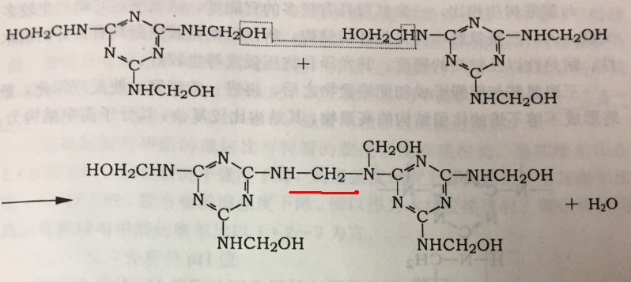
NO.1

Slide 69
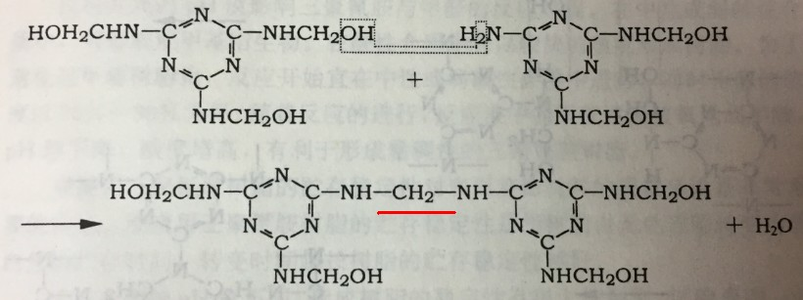
NO.2

Slide 70
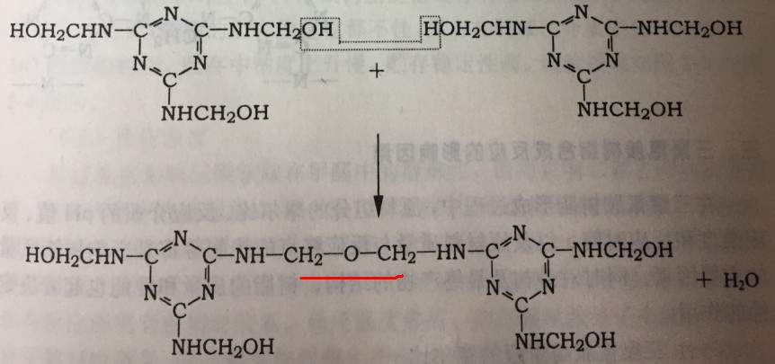
NO.3

Slide 71
Melamine-Formaldehyde Condensation
Methylene and ether bridges are formed and the molecular size of the resin increases rapidly.
Notes:
Bulk大量，批量，主体；

Slide 72
Melamine-Formaldehyde Condensation
These intermediate condensation products constitute the large bulk of the commercial MF resins.

Slide 73
Melamine-Formaldehyde Condensation
The final curing process transforms the intermediates to the desired MF insoluble and infusible resins through the reaction of amino and methylol groups which are still available for reaction.

Slide 74
Melamine-Formaldehyde Condensation
A simplified schematic formula of cured MF resin has been given by Koehler and Fry .
Notes:
Schematic图解的，示意的，概略的； formula 配方，分子式；

Slide 75
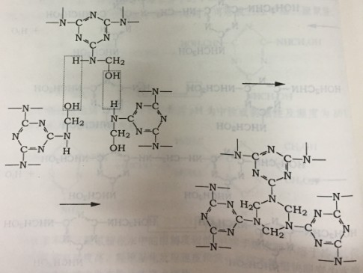

Slide 76
Melamine-Formaldehyde Condensation
They emphasize the presence of ether bridges besides unreacted methylol groups, and the methylene bridges.

Slide 77
Melamine-Formaldehyde Condensation
This is because in curing MF resins at temperatures of up to 100°C, no substantial amounts of formaldehyde are liberated.
Notes:
substantial amounts：足够数量的；

Slide 78
Melamine-Formaldehyde Condensation
Only small quantities are liberated during curing up to 150°C.
However, UF resins curing under the same conditions liberate a great deal of formaldehyde

Slide 79
Melamine-Formaldehyde Condensation
Wohnsieldler, Updegraff, and Hunt have tried to correlate the best physical properties of melamine-formaldehyde resins with the degree of curing or condensation.

Slide 80
Melamine-Formaldehyde Condensation
They have found that the various properties attain their peak at different degrees of reaction.
However the best physical properties of MF resins were always associated with significant cross-linking
Notes:
Attain达到，成就，完成，达到。

Slide 81
Summary
difference between MF and UF
addition reaction of melamine with formaldehyde
condensation reaction of methylolmelamines
MF curing

Slide 82
Reaction Kinetics of UF

Slide 83
Reaction Kinetics ：Urea-Formaldehyde
The kinetics of the formation of mono-methylol-ureas , di-methylol-ureas and simple urea-formaldehyde polymers have been studied extensively.

Slide 84
Reaction Kinetics ：Urea-Formaldehyde
The formation of mono-methylol-urea in weak acid or alkaline aqueous solutions is characterized by an initial fast phase followed by a slow bimolecular reaction.

Slide 85
Reaction Kinetics ：Urea-Formaldehyde
The reaction is reversible. The formation of methylol-urea is bi-molecular and its dissociation is monomolecular.
Notes:
Reversible：可逆的； dissociation离解；monomolecular：单分子的，一分子的，单层分子 的；

Slide 86
Reaction Kinetics ：Urea-Formaldehyde
The rate of reaction varies according to the pH with a minimum rate of reaction in the pH range 5-8 for a molar ratio of 1:1 for urea/formaldehyde and a pH of 6.5 for a 1:2 molar ratio.

Slide 87
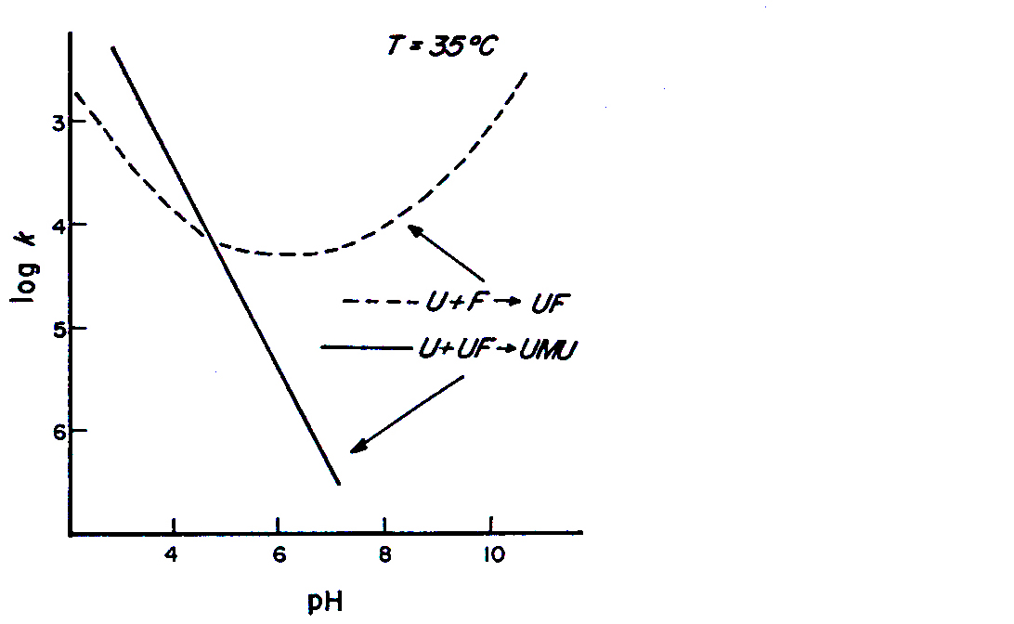
Reaction Kinetics ：Urea-Formaldehyde
Influence of pH on the addition and condensation reactions of urea and HCHO. U, urea; F, HCHO; M, -CH₂-

Slide 88
Reaction Kinetics ：Urea-Formaldehyde
The 1:2 urea/formaldehyde reaction has been proved to be three times slower than the 1:1 molar ratio reaction.

Slide 89
Reaction Kinetics ：Urea-Formaldehyde
The dehydration of formaldehyde (present largely as methylene glycol) and the formation of the urea anion are considered to be the controlling factors.
Notes:
Glycol甘醇，1，2亚甲基二醇；二元醇的类名；methylene glycol亚甲基二醇
阴离子anion ；

Slide 90
Reaction Kinetics ：Urea-Formaldehyde
The rapid initial addition reaction of urea and formaldehyde is followed by a slower condensation, which results in the formation of polymers.

Slide 91
Reaction Kinetics ：Urea-Formaldehyde
The rate of the condensation of urea with mono-methylol-urea to form methylene-bis-urea (or UF “dimers”) is also pH dependent.
Notes:
Bis:两个，双；

Slide 92
Reaction Kinetics ：Urea-Formaldehyde
Reaction rate decreases from a pH of 2-3 to neutral pH value. Almost no condensation occurs at alkaline pH values.

Slide 93
Reaction Kinetics ：Urea-Formaldehyde
The marked influence of the pH range on the reactions rates indicates that such reactions are the hydrogen-ion-catalyzed type.

Slide 94
Reversible reaction
Reaction Kinetics ：Urea-Formaldehyde
The initial addition of formaldehyde to urea in dilute solutions (0.1 M) is reversible, and is subject to general acid and base catalysis.

Slide 95
Reaction Kinetics ：Urea-Formaldehyde
The forward bimolecular reaction has an activation energy of 13 kcal/mol. The reverse unimolecular reaction has an activation energy of 19 kcal/mol .

Slide 96
Reaction Kinetics ：Urea-Formaldehyde
The proposed mechanism of the acid catalysis is that a protonated formaldehyde carbocation with urea. The alkaline-catalyzed reaction proceeds instead through the reaction of the urea anion with formaldehyde.
Notes:
Protonated质子化了的； carbocation碳正离子，下碳离子； anion阴离子；
形成二羟甲基脲的反应与摩尔比为1：1的单羟甲基脲形成在反应原理、活化能上接近。

Slide 97
Reaction Kinetics ：Urea-Formaldehyde
The subsequent reaction of monomethylolurea with formaldehyde in dilute solution, to give dimethylolurea, corresponds closely to the 1:1 monomethylolurea formation reaction in type, reaction mechanism, and activation energies .
Notes:
Protonated质子化了的； carbocation碳正离子，下碳离子； anion阴离子；
形成二羟甲基脲的反应与摩尔比为1：1的单羟甲基脲形成在反应原理、活化能上接近。

Slide 98
Reaction Kinetics ：Urea-Formaldehyde
It is also reversible in concentrated solutions (2-4 M) at pH 7.0, and at 35ºC, the addition reactions have the same rate constants as in dilute solutions and the reactions are very similar.

Slide 99
Reaction Kinetics ：Urea-Formaldehyde
No tri-methylol-urea is detectable in the reactions of urea and formaldehyde in dilute solutions containing a 6-8 M excess of formaldehyde.
Notes:
tri-希腊及拉丁字头：3

Slide 100
Reaction Kinetics ：Urea-Formaldehyde
The rates of introduction into the urea molecule of one, two, and three methylol groups has been estimated to have the ratio 9:3:1, respectively.

Slide 101
Reaction Kinetics ：Urea-Formaldehyde
The formations of N,N‘-di-methylol-urea and of tri-methylol-urea are also bimolecular reaction, and their decomposition are monomolecular.

Slide 102
Reaction Kinetics ：Urea-Formaldehyde
The formation of N,N'-di-methylol-urea from mono-methylol-urea is about 1.5 times that of mono-methylol-urea from urea.

Slide 103
Reaction Kinetics ：Urea-Formaldehyde
The decomposition of N,N'-di-methylol-urea to mono-methylol-urea is three times that of mono-methylol-urea to urea.

Slide 104
Hydrolization of methylene-bis-urea
Reaction Kinetics ：Urea-Formaldehyde
The capability of methylene-bis-urea to hydrolyze to urea and methylol-urea in weak acid solutions (pH 3--5) indicates the reversibility of the methylene link and its lability in weak acid moisture.

Slide 105
Reaction Kinetics ：Urea-Formaldehyde
It explains the slow release of formaldehyde over a long time in particleboard and other wood products manufactured with UF resins.

Slide 106
Reaction Kinetics ：Urea-Formaldehyde
Equilibrium constants for urea-formaldehyde-methylol-ureas have been theoretically derived, and found to agree with experimental results.

Slide 107
Reaction Kinetics ：Urea-Formaldehyde
Cannizzaro reaction
A few studies have been done on the pH changes in urea-formaldehyde solutions during reactions. The main cause of the observed pH. drop was the Cannizzaro reaction, disproportioning formaldehyde to methanol and formic acid. Oxidation by atmospheric oxygen also contributed.
Notes:
Disproportioning, disproportionate:歧化；methanol甲醇

Slide 108
Reaction Kinetics ：Urea-Formaldehyde
The latter could be eliminated by working in an inert atmosphere. The use of a solvent which will not mix with water as a surface layer, inhibits the formation of methylene ureas.
Notes:
Inert：惰性的

Slide 109
Reaction Kinetics ：Urea-Formaldehyde
Using ammonia as neutralizing agent. And an initial rise in the pH of the reaction mixture has been observed. This has been attributed to the decomposition of unstable methylol-amines.

Slide 110
Reaction Kinetics ：Urea-Formaldehyde
The effect of methanol on the reactions has also been investigated.
It slightly retards the addition reactions. Methanol hinders the formation of methylene links in the condensation reactions.

Slide 111
Summary
Addition reaction
Condensation reaction
Hydrogen-ion-catalyze reaction
Reversible reaction
Hydrolization
Cannizzaro reaction

Slide 112
General Principles of Manufacture and Application

Slide 113
General Principles of Manufacture and Application
It is very important to control the size of molecules by the condensation reaction in the commercial production of urea-formaldehyde (UF), melamine-formaldehyde (MF), and melamine-urea-maldehyde (MUF) resins, since their properties change continuously as them grow larger.

Slide 114
General Principles of Manufacture and Application
The most perceptible change is the increase in viscosity. Low-viscosity syrups are first formed. These change into high-viscosity syrups which are clear to turbid.
Notes:
syrups：糖浆，浆，糖汁； turbid：混浊的，纷乱的；

Slide 115
General Principles of Manufacture and Application
These products may still be completely water soluble, but they may prove to be alcohol insoluble in later stages of the reaction.

Slide 116
General Principles of Manufacture and Application
Molecular weight may vary from a few hundred to a few thousand with a wide range of molecular size.

Slide 117
General Principles of Manufacture and Application
These molecules are built up by water splitting off at random between reactive groups of neighboring molecules, thereby increasing their size.
Notes:
splitting:分解，裂解，分开，剖开，劈裂。+off:裂口，裂开，分离；

Slide 118
General Principles of Manufacture and Application
Once their solubility, viscosity, pH, concentration, and so on, have been determined, they constitute the resins available commercially.

Slide 119
General Principles of Manufacture and Application
The most important factors influencing the final properties of amino-resins in industrial manufacture are：
the purity of the reagent,
the molar proportions of the materials used,
the preparation process used,
the pH variation and control.

Slide 120
1. Purity of Reagents

Slide 121
Formaldehyde
Purity of Reagents
Every commercial grade of formaldehyde contains some methanol from its manufacture in order to stabilize the formalin solution.

Slide 122
Purity of Reagents
If methanol is not present, paraformaldehyde is formed. During storage, first turbid solutions, and then white colloidal deposits are formed. The process is faster in winter than summer.

Slide 123
Purity of Reagents
Formalin solution with a 37--41% content of formaldehyde are usually stabilized with 6-12% methanol according to the storage temperature.

Slide 124
Purity of Reagents
A 30% solution of formaldehyde needs less methanol to stabilize (i.e., from traces up to 1%). Higher concentrations of formaldehyde require higher methanol amounts.

Slide 125
Purity of Reagents
In MF resins, no difference exists in the water resistance of the cured resin whether formaldehyde containing methanol is used or whether methanol-free formaldehyde is used.

Slide 126
Purity of Reagents
However, in UF resins, the methanol content makes a considerable difference.

Slide 127
Purity of Reagents
With methanol-free formaldehyde regular UF resins can be manufactured with normal boiling-water absorption (+2%).

Slide 128
Purity of Reagents
With formaldehyde containing methanol (i.e., 40% formalin solution with 8--11% methanol), and identical manufacturing conditions, the UF resins obtained are much less stabile in water and have an unusually high hot-water absorption (6-10%).

Slide 129
Purity of Reagents
This unusual effect is due to the formation of methylated urea-formaldehyde resins, which remain unchanged on curing. And result in their easy solubility in water, destroy the water resistance.

Slide 130
Purity of Reagents
This does not occur with melamine-formaldehyde resins because the cured MF resins have a higher cross-link density and are less soluble, and therefore less water sensitive. They are also more stable at higher temperature.

Slide 131
Purity of Reagents
To avoid this problem, either unstabilized formaldehyde is used or methanol is distilled from commercial formaldehyde solutions before urea is dissolved in it.

Slide 132
Purity of Reagents
Commercial UF resins are generally manufactured by using formalin solutions which contain less that 1% methanol and which are stored in heated tanks at +60°C.

Slide 133
Melamine
Purity of Reagents
In the case of melamine resins, attention must be paid to the formation of hydrolysis products of melamine before manufacture starts.

Slide 134
Purity of Reagents
The hydrolysis products of melamine are obtained when the amino groups of melamine are gradually replaced by hydroxyl groups. Completed hydrolysis produces is cyanuric acid.

Slide 135
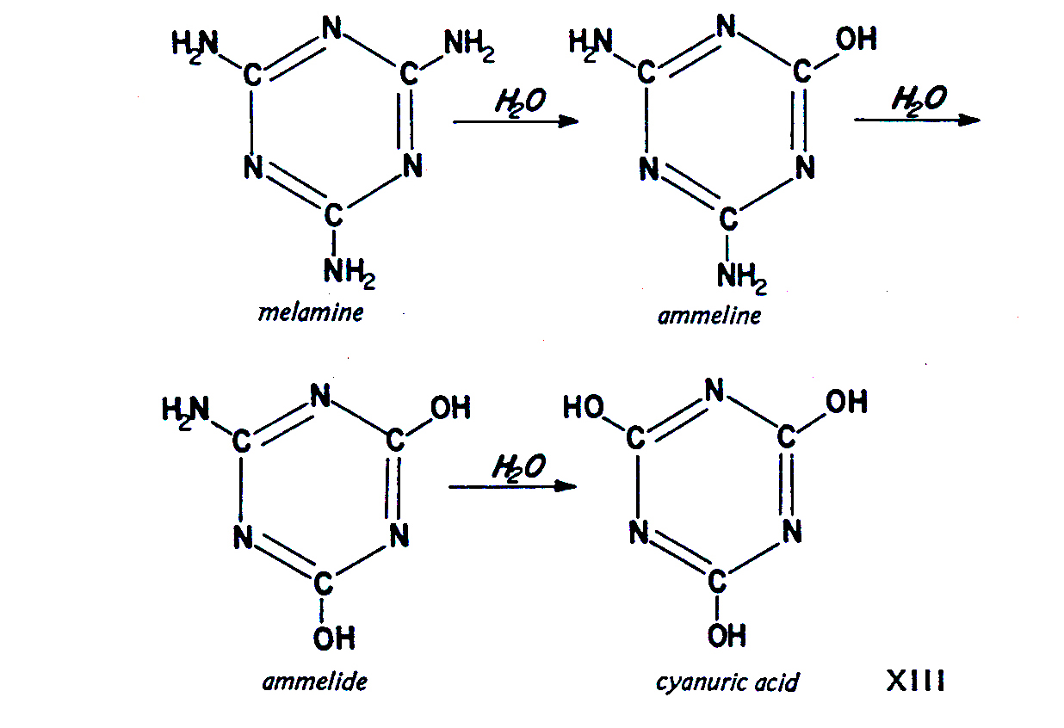
Notes:
ammeline:三聚氰酸二酰胺，氰尿二酰胺；ammelide:三聚氰酸一酰胺，氰尿酰胺；

Slide 136
Purity of Reagents
Ammeline and ammelide can be regarded as partial amides of cyanuric acid. They are acids and be useless in resin production.

Slide 137
Purity of Reagents
They are very undesirable by-products in the manufacture of melamine because of their catalytic effect in the subsequent melamine-formaldehyde resin production, due to their acidic nature.

Slide 138
Purity of Reagents
Both must be removed from crude melamine by an alkali wash and/or crystallization of the crude melamine.

Slide 139
Summary
Formaldehyde
Methanol
Melamine
Hydrolysis

Slide 140
2.Proportions of Materials Used

Slide 141
Second urea
Proportions of Materials Used
The molar ratio of urea to formaldehyde used in UF resin manufacture is in the range 1:1.4--1:1.7, with the formaldehyde in the form of an aqueous solution.

Slide 142
Proportions of Materials Used
The most important method for the preparation of commercial UF resin adhesives is the addition of a second amount of urea during the preparation reaction.

Slide 143
Proportions of Materials Used
This consists of reacting urea and formaldehyde in more than equivalent proportions（当量比）. Generally, an initial urea/formaldehyde molar ratio of 1:2.2 is used.

Slide 144
Proportions of Materials Used
In this case， methylolation can be carried out in a much shorter time, by using temperatures of up to boiling point.

Slide 145
Proportions of Materials Used
At about 90ºC the exothermic reaction usually leads to vigorous boiling. The boiling continues without external heating and the mixture is maintained under reflux.

Slide 146
Proportions of Materials Used
When the exotherm and boiling subsides, the methylol compounds have formed, and the reaction is completed under reflux, preferably by adding a trace of acid to act as a catalyst until the viscosity of solution increases.
Notes:
Subside：降落，平息，消落，下沉；

Slide 147
Proportions of Materials Used
More urea (called second urea) is added to consume（消耗） the excess of formaldehyde, until the molar ratio of urea to formaldehyde is the range 1:1.4-1:1.7.

Slide 148
Proportions of Materials Used
The final addition of urea can be done in one operation, or the urea may be added at suitable time intervals in smaller lots.

Slide 149
Proportions of Materials Used
As soon as the right viscosity is reached, the resin solution is cooled to about 25-30°C.

Slide 150
Proportions of Materials Used
The excess water is eliminated by vacuum distillation until a resin solids concentration of 64--65% is reached, and the pH adjusted to achieve suitable storage life.
Notes:
shelf life:贮存期限，货架寿命；

Slide 151
Bonding strength
Proportions of Materials Used
The chemical constitution of UF resin (which can be influenced by molar ratio, type and degree of condensation, and hydrogen-bonding ability) is an important factor relating to the durability of UF adhesive wood bonds.

Slide 152
Proportions of Materials Used
Several authors have studied the preparation, properties, and adhesive characteristics of UF resins in plywood.

Slide 153
Proportions of Materials Used
They report that the properties and bonding strengths of UF adhesives for plywood are primarily influenced by the degree of condensation and the molar ratio of the resin.

Slide 154
Proportions of Materials Used
They found that for two resins prepared under identical conditions, the one with a urea/formaldehyde molar ratio of 1:1.6 has better water resistance than the one with the ratio 1:2.0 when extended with wheat flour.

Slide 155
Proportions of Materials Used
Rice shows from aging studies on commercial UF resins that higher resin viscosities which are related to higher molecular weights result in a more durable glue-wood bond.

Slide 156
Proportions of Materials Used
Inoue, Kawai, and Itow report that bonding strength increases with the degree of condensation in a resin with a molar ratio 1:1.2.

Slide 157
Adhesion strength
Proportions of Materials Used
They note that adhesion strength appears to be the highest at a relatively low average molecular weight, and that it decreases with further condensation.

Slide 158
Proportions of Materials Used
The significance of a second addition of urea to improve adhesion strength has been clearly demonstrated. They conclude that di-methylol-ureas are the main components governing the adhesive force between glue and wood, while higher molecular weight species govern the cohesive force.

Slide 159
Proportions of Materials Used
Other factors, such as the degree of cure and the type and quantity of hardener, have also been reported to affect the water resistance of UF resins.

Slide 160
Durability
Proportions of Materials Used
In an important article, Steiner indicates that resins with higher molar ratios are more durable than those with a lower formaldehyde/ urea ratio.

Slide 161
Proportions of Materials Used
He concludes that for samples without fillers, urea/formaldehyde molar ratios of 1:2.0 and 1:1.8 show better durability at all levels of second-urea addition than molar ratios of 1:1.6 and 1:1.4.

Slide 162
Proportions of Materials Used
When fillers, such as walnut shell flour, are incorporated, resins of molar ratio 1:1.6 have improved durability. And both molar ratios of 1:2.0 and 1:1.8 have a notably slower deterioration rate than resins with a ratio 1:1.4.

Slide 163
Proportions of Materials Used
While the rate of bond deterioration is an important concept in establishing durability ranking, which does not take the initial bond quality in account.

Slide 164
Proportions of Materials Used
For UF resins without filler, increased second urea addition improves bond quality, especially in the low molar ratios. This improvement, however, is maximized after a 20--30% addition.

Slide 165
Proportions of Materials Used
In all cases, the higher molar ratios resins tend to exhibit an overall better initial bond quality.

Slide 166
Proportions of Materials Used
To conclude, UF resins of urea/form-aldehyde molar ratio ranges of 1:1.8-2.0 exhibit slower bond deterioration than resins of molar ratio ranges 1:1.4-1:1.6. under accelerated aging conditions.

Slide 167
Proportions of Materials Used
Glues containing filler, made from resins with a molar ratio of 1:1.4-1.6, show improved durability with increased amounts of second urea.

Slide 168
Proportions of Materials Used
Any consideration of the obvious improvements in durability resulting from an increased second urea addition must also reflect on the amount of methylol groups available.

Slide 169
Proportions of Materials Used
The mechanism of condensation requires sufficient methylol groups to be present before all the second urea can be incorporated in the UF polymers.

Slide 170
Proportions of Materials Used
It appears that a minimum amount of methylol is necessary for a satisfactory wood-glue bond.

Slide 171
Proportions of Materials Used
This supports the concept that methylolureas are responsible for the adhesive force of the UF resin during wood-glue bond formation, while higher condensation products provide the cohesive force.

Slide 172
Proportions of Materials Used
The methylol groups of the UF resin have been found to form ether links with cellulose, which explains their strong effect on the adhesion characteristics of UF resins.

Slide 173
Proportions of Materials Used
Therefore, the higher the amount of methylol groups, the better adhesion of glue to wood.

Slide 174
Summary
U/F ratio
Second urea
Bonding strength
Adhesion strength
Durability

Slide 175
Control of the Reaction

Slide 176
pH
pH Control
The control of the pH during the reactions of urea or melamine with formaldehyde is of paramount importance.

Slide 177
Control of the Reaction
Careful pH control during the reaction of urea or melamine with formaldehyde done in combination with repeated tests for solubility and viscosity are the methods used to control the molecular weight of the resins.

Slide 178
Control of the Reaction
The increase of molecular size can more easily be seen in UF resins than in MF resins. This is done by measuring viscosity in UF resins and by determining solubility during condensation in MF resins.

Slide 179
Control of the Reaction
Repeated or even continuous determination of the pH during the reaction, because in warm formaldehyde solutions which are exposed to air, formaldehyde is slowly oxidized to formic acid (Cannizzaro reaction).

Slide 180
Control of the Reaction
Methylolation and subsequent resinification can be carried out by neutralizing formic acid with ammonia or another amine, instead of an inorganic alkali.

Slide 181
Control of the Reaction
The addition reaction of amines and formaldehyde is slower than the neutralization reaction, and consequently formic acid is neutralized.

Slide 182
Control of the Reaction
Methylolation of urea or melamine then occurs in a neutral or slightly basic medium. Therefore, the critical stage of methylol formation is safely passed.

Slide 183
Control of the Reaction
By carefully controlling the pH and viscosity, the amino-resin solution can be kept at the desired condensation stage, by arresting the reaction.

Slide 184
Control of the Reaction
This is done by cooling and by bringing the pH to the alkali， which guarantees best stability.

Slide 185
Control of the Reaction
For a UF resin, for instance, the pH of the formaldehyde solution as purchased is 3.5, and the pH after adding ammonia and urea is 8.5.

Slide 186
Control of the Reaction
The series of reactions are then as follows: formic acid is neutralized, and methylol-ureas are formed.

Slide 187
Control of the Reaction
At the same time, there is a slow liberation of formic acid due to the equilibrium.

Slide 188
Control of the Reaction
Parallel to this is the slow formation of hexamethylenetetramine as a result of the reaction between six molecules of formaldehyde and four molecules of ammonia. Then pH drops from 8.5 to 5.5.

Slide 189
Control of the Reaction
The condensation reaction of methylolurea to UF resin occurs at pH 5.0--4.0.

Slide 190
Control of the Reaction
After the desired viscosity has been reached, the pH is raised to 7.5-8.0 by adding diluted caustic soda.

Slide 191
Control of the Reaction
The careful control of the pH makes it possible to achieve the safe manufacture of UF resins. Some manufacturers prefer this ammonia method since it also gives a very good resin quality.

Slide 192
Flow
Control of the Reaction
Factors other than the pH of the resins must be taken into account in meeting this demand. One of the most important is the final condensation stage of the amino resin.

Slide 193
Control of the Reaction
Control of the average molecular size of the finished resin is essential for the correct flow in plywood and particleboard applications while in the hot press prior to curing.

Slide 194
Control of the Reaction
Too low a level of condensation (i.e., Low molecular weight resins) may give too much flow; the resin "runs away" from the wood or rapidly sinks into it under pressure, leaving "starved" glue lines.

Slide 195
Control of the Reaction
This can be corrected by lowering the pH by adding an acid or acid-producing substance, usually a curing agent, hardening catalyst, or simply hardener.

Slide 196
Control of the Reaction
If a resin of too high a condensation stage (i.e., high molecular weight resins) is present, its flow under normal pressure and temperature may be too low to produce good results.

Slide 197
Control of the Reaction
This can usually be corrected by adding flow agents to it, provided that at least some flow is left in the resin.

Slide 198
Control of the Reaction
It is generally an advantage to produce resins with ample flow in the factory.

Slide 199
Control of the Reaction
Resins that have lost part of their flow during manufacture or storage must be corrected by the addition of a flow agent.

Slide 200
Control of the Reaction
The simplest means is often the addition of water sprayed on the compound and mixed in well. If a resin is still capable of flowing, this procedure produces a resin with properties that are still acceptable.

Slide 201
Control of the Reaction
In cases where moisture content control is critical, it may be necessary to allow a little more time for "heating" to let the added moisture escape.

Slide 202
Control of the Reaction
However, if the flow is very low, and large quantities of water must be used to bring the flow back to normal, this method is not recommended.

Slide 203
Control of the Reaction
The large amount of water would cause longer ‘breathing“ times to be necessary due to excessive volatile components, and excessive shrinkage may take place, causing excessive stress on the glue lines.

Slide 204
Control of the Reaction
The best way to correct flow in these cases is to mix the resin with large amounts of an equal resin of the same quality which has a higher flow. Any proportion may be used to bring the flow back to normal.

Slide 205
Control of the Reaction
If increased flow is desired, 0.5--2.0% of spray-dried UF or MF resin can be added to function as a flow agent. Methylol compounds, such as dimethylolurea, also increase flow, but they increase the water released during reaction more than spray-dried resins.

Slide 206
Curing agents
Control of the Reaction
Many substances have been suggested as curing agents. These include the following acid products:

Slide 207
Control of the Reaction
(1) boric acid
(2) phosphoric acid
(3) acid sulfates
(4) hydrochlorides
(5) ammonium salts of phosphoric or poly-phosphoric acid
(6) sodium or barium ethyl sulfate
(7) acid salts of hexamethylenetetramine

Slide 208
Control of the Reaction
(8) phtalic anhydride
(9) phtalic acid
(10) acid resins such as poly basic acid-polyhydric alcohol
(11) oxalic acid or its ammonium salts, and many others.

Slide 209
Control of the Reaction
However, the most widely used curing agents in the wood products industry are still ammonium chloride（氯化铵） or ammonium sulfate（硫酸铵）.

Slide 210
Control of the Reaction
Their effect can be altered by retarding the reaction of the resin. This is done by simultaneously adding small amounts of ammonia solution (which is eliminated during hot curing) to lengthen the pot life（储存期） of the glue mix.

Slide 211
Control of the Reaction
Latent catalysts, which produce acid only on heating, may also be used, such as dimethyloxalate （草酸二甲酯）and other easily hydrolyzable esters; or substances such as 0.1--0.2% of bromohydrocinnamic acid（溴苯丙酸）, dibromosuccinic acid（溴丁二酸）, 1,3-dichloro- 2-propanol（二氯异丙醇）, and so on.

Slide 212
Summary
pH
Flow
Curing agents

Slide 213
Thanks!
Question?

